Slide 1
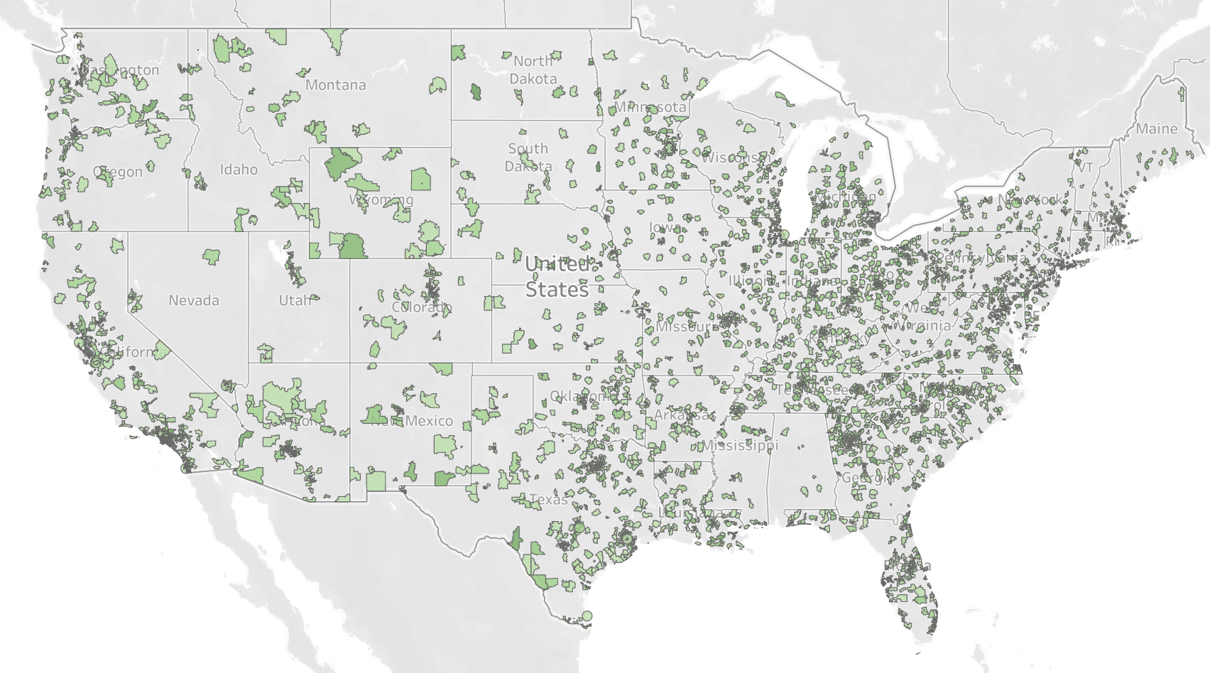
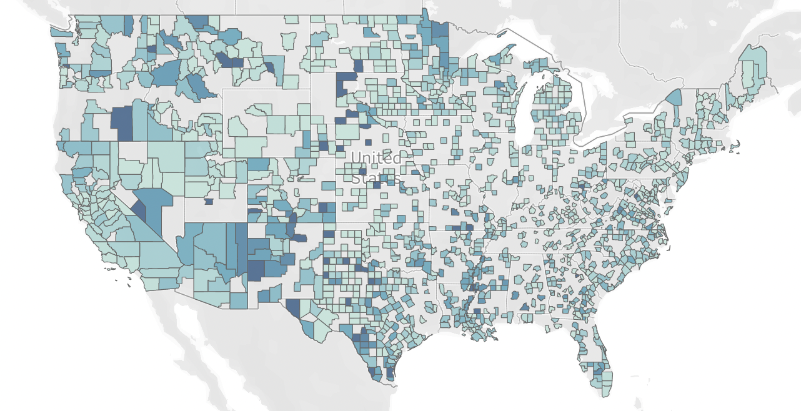
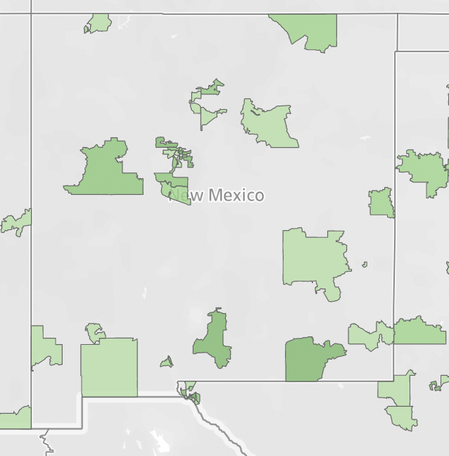
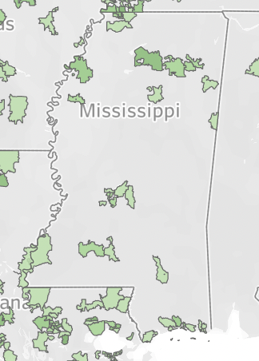
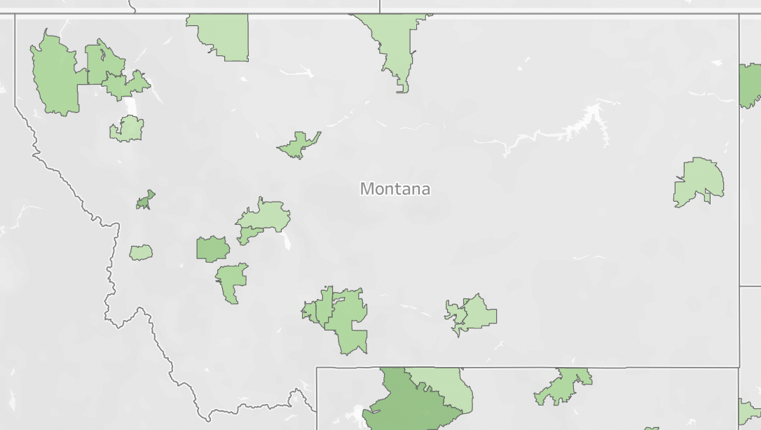
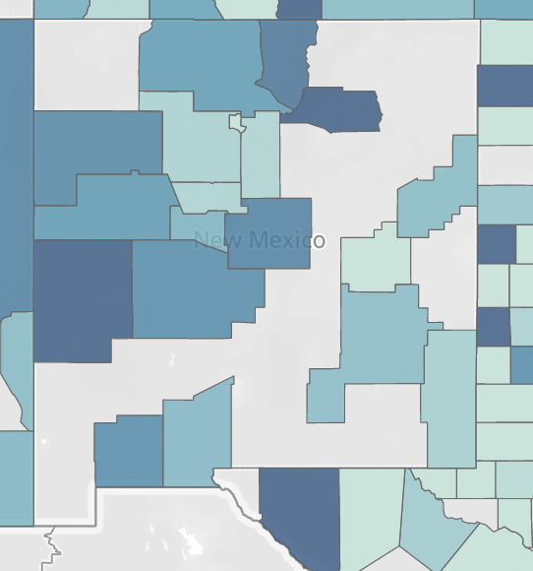
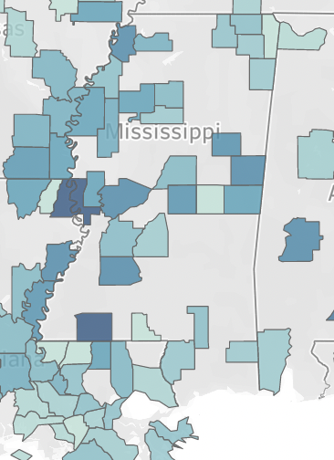
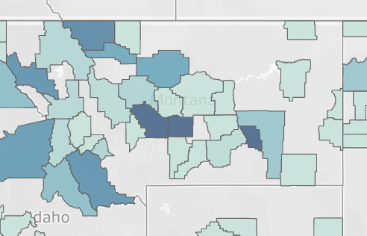
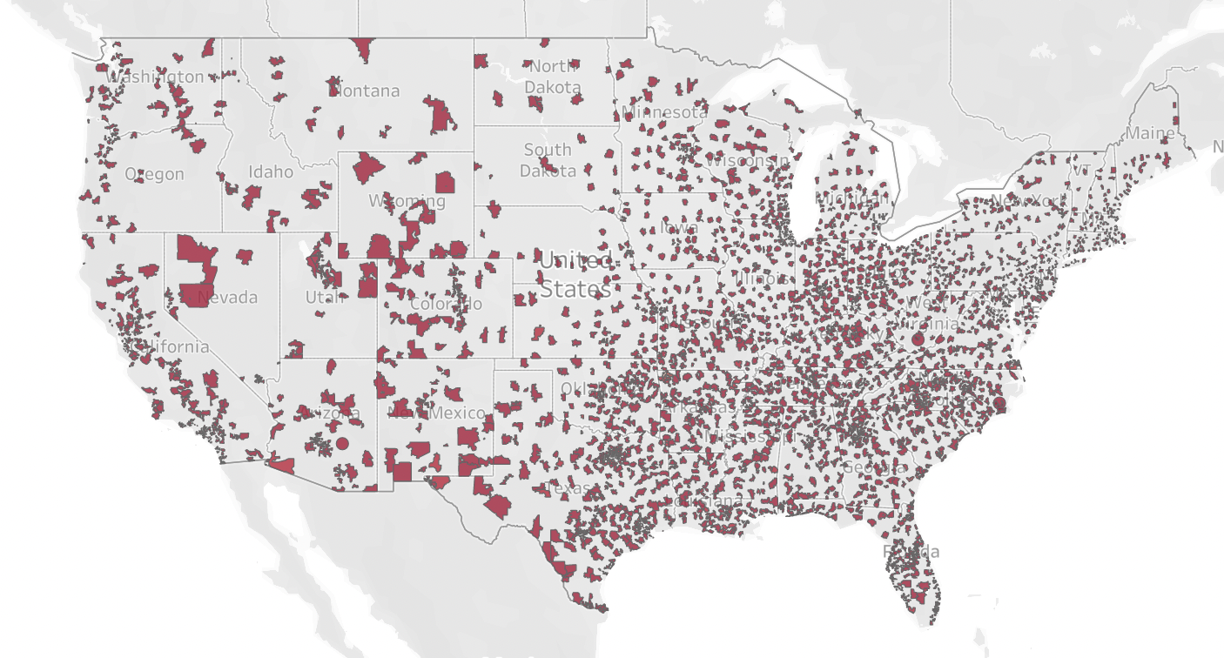
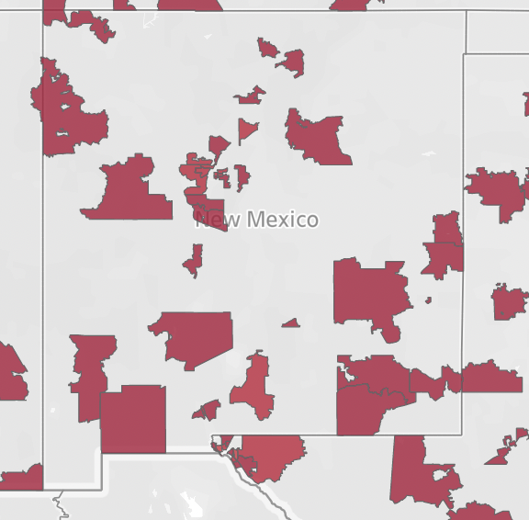
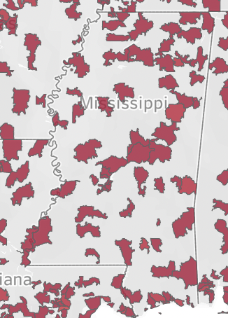
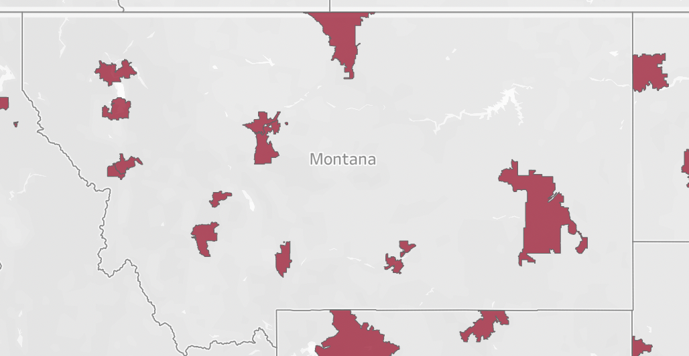
Access to Affordable and Nutritious Food: Comparing the Number of Walmarts to the Number of Fast Food Restaurants in America’s Food Deserts
Abigail Foster, Fall 2021
Kenyon College
IPHS 200, Professors Elkins and Chun
Introduction
Methodology
Conclusion and Next Steps
In June of 2009, the Department of Agriculture wrote a report to Congress entitled “Access to Affordable and Nutritious Food: Measuring and Understanding Food Deserts and Their Consequences.” This one hundred and sixty page report outlined the fact that millions of Americans live without consistent access to affordable food; 2.3 million households are more than a mile away from a supermarket without a car they can use, and 11.5 million people live in a low-income are greater than one mile away from a grocery store. The report also details how limited access to food that is reasonably priced and healthy can lead to people living in food deserts becoming prone to obesity and related health concerns like diabetes.
In 2011, two years after this report to Congress was authored, the Walmart corporation joined First Lady Michelle Obama in her campaign to end childhood obesity by pledging to open hundreds of new stores in food deserts across the U.S. Supercenters like Walmart can provide fresh produce and healthy food options to their customers at an affordable cost, making them a good option to help combat food deserts across the U.S. These stores would give Americans living in food deserts an important alternative to fast food restaurants, which can provide cheap and filling food to people who would otherwise go hungry.
For my data analytics project, I aim to investigate the number of Walmarts around food deserts in the U.S. and compare that with the number of fast food restaurants in these same locations. Through this I hope to see whether or not the promise Walmart made ten years ago has materially impacted the lives of Americans living in food deserts, and through that understand how much work still needs to be done in combatting food insecurity throughout America.
In my research I compared three different datasets: one containing the location of 10,000 fast food restaurants in the U.S., one containing the location of 4,639 Walmarts in the U.S., and one. I found all of these through Kaggle, though the original data was all sourced from different places: the data on the Walmart stores was scraped from walmart.com, the fast food data was provided by Datafini, and the data on food deserts was taken from the Department of Agriculture's Food Access Research Atlas. I used Tableau to visualize my data and draw meaningful conclusions between the three different sets.
The three images on the left show the three data sets projected onto a map of the United States; in green are the fast food restaurants, in red are the Walmart locations, and in blue are food deserts. It must be noted that not all of these three maps are showing the same space—the fast food and Walmart datasets both included the zip code which the store was in. I felt that this was a good way to visually present the information because the areas are not too small to see on a map of the entire country but are also not too large to prevent meaningful conclusions. However, the dataset on food deserts didn’t include the zip code of the restaurants. Instead I used the county, which was included in the data. While this prevents any exact analysis of specific counties, I feel that it allows for a visual comparison that effectively shows where these three types of locations overlap (or, more importantly, do not overlap).
For the fast food and Walmart data, a colored portion of land indicates that there is at least one store location in that area. There is a color gradient; on the fast food map, a darker green indicates more restaurants in that area, and on the Walmart map a darker red (which looks more like black) indicates the same. The food desert data, however, is slightly different. In the introduction to the dataset on Kaggle, the person who uploaded it notes that the Department of Agriculture defines a food desert as a place with inhabitants “living more than one mile from a supermarket in urban/suburban areas, and more than 10 miles from a supermarket in rural areas.” Therefore, the darker blue indicates an area that is further away from a grocery store.
Based on my research, it does seem that, in many areas of the country without much access to food, Walmart provides a healthy and accessible alternative to fast food restaurants. In places like New Mexico and Mississippi, Walmarts are more accessible to people in food deserts than fast food is. However, there are still places, like Montana, where fast food restaurants are available to more of the population. In order to fulfill the promise they made ten years ago, Walmart must focus specifically on opening more locations in the western part of the United States.
One direction I would be interested in taking this research would be looking at what groups are attempting to provide food to the people living in these food deserts besides large corporations like Walmart. Of course, Walmart has the money to invest in opening more locations, which is why they were able to commit to this endeavor. Certainly, it is better that people have access to produce from a place like Walmart, rather than being forced to eat only fast food. However, I believe a more long-term solution to America’s food deserts would involve a more local grassroots effort which puts the production of healthy food into the communities who need it, rather than having this food brought in by a large corporation.
Fast Food Restaurants by Zip Code
New Mexico:
Mississippi:
Montana:
Findings
Background
U.S. Counties Containing Food Deserts
By comparing these three maps, we can see that frequently the areas on the food desert map have neither a Walmart nor a fast food restaurant near them. This makes sense; by definition these locations have very limited access to food. To draw a meaningful conclusion, we must then look at the area surrounding these food deserts. However, we also see that both the Walmarts and the fast food restaurants are concentrated strongly towards the east part of the country, with far fewer of each towards the west. This could perhaps be attributed to the greater population density in the east coast compared to the western part of the country.
In order to draw more specific conclusions, I will look in particular at Montana, New Mexico, and Mississippi: three states with a large number of food deserts.
Montana contains several counties with food deserts, especially in the western half of the state. All of the fast food restaurants in the state fall within nineteen zip codes, and all of the Walmarts only eleven. This means that there fast food restaurants are more spread out across the state, making them more accessible to more people.
In New Mexico, on the other hand, there are far more zip codes with Walmarts than there are with fast food restaurants. There are also Walmarts in the northwest of the state—an area with a high amount of food deserts—where there are notably few fast food restaurants.
Mississippi, too, has far more zip codes containing Walmarts than fast food restaurants. Additionally, the Walmarts are evenly spread out across the state, meaning that people living in food deserts will have equal access to them as people living in more prosperous parts of the state. Most of the fast food restaurants, on the other hand, are not located near food deserts.
New Mexico and Mississippi are two examples of places where Walmart does provide a healthy food option that is more accessible than fast food restaurants. However, this is not true for the entirety of the country, as we see from looking at Montana.
Though a combination of some of my datasets have been considered in conjunction with one another, no one has yet investigated the relationship between food deserts, Walmart locations, and fast food locations. I was able to find much scholarship on food deserts and Walmart; for example, a column piece from the Center of Economic Policy and Research from 2019 entitled “Walmart Supercenters fight food insecurity” investigates how new locations of the chain store can help families who have limited access to food. Additionally, the correlation between food deserts and fast food restaurants has been noted before. In fact, there’s a term for a place where fast food is the food most readily available to most people: food swamp. A study from the National Center for Biotechnology Information looks at the prominence of fast food restaurants in different areas of the country.
Despite the fact that there has been research into the relationship between Walmart and food deserts and, separately, research about food deserts and fast food restaurants, no one has looked at all three together—this is something I hope to provide to the field of study.
Sources
Breneman et al. “Access to Affordable and Nutritious Food: Measuring and Understanding Food Deserts and their Consequences.” Report to Congress, June 2009. https://www.ers.usda.gov/webdocs/publications/42711/12716_ap036_1_.pdf
Courtemanche et al. “Walmart Supercenters fight food insecurity.” July 18, 2019. VoxEU CEPR. https://voxeu.org/article/walmart-supercenters-fight-food-insecurity
Hilmers, Hilmers, and Dave. “Neighborhood Disparities in Access to Healthy Foods and Their Effects on Environmental Justice.” September 2012. US National Institutes of Health’s National Library of Medicine. https://www.ncbi.nlm.nih.gov/pmc/articles/PMC3482049/
“Making Food Healthier and Healthier Food More Affordable.” Healthier Food Initiative Announcement, Walmart Corporation. https://corporate.walmart.com/_news_/executive-viewpoints/leslie-dach-healthier-food-initiative-announcement
Marlowe, Beth. “Michelle Obama joins forces with Walmart, Walgreens to battle food deserts.” July 20, 2011. The Washington Post, https://www.washingtonpost.com/blogs/44/post/michelle-obama-joins-forces-with-walmart-walgreens-to-battle-food-deserts/2011/07/20/gIQAKn7oPI_blog.html.
Walmart Locations by Zip Code

